Slide 1
Why Super Computers & the Geek Squad started in Minnesota (not Silicon Valley).

Slide 2
1946 It all begins with Engineering Research Associates…
When WWII ended so did the work of a dream team of code breakers working for the Navy.
To keep the great talent together, the Navy hired them to work for a “private company” they created called Engineering Research Associates (ERA) based in St Paul, Minnesota.

Slide 3
1950
ERA invents the first
stored memory computer, opening up computing to an unlimited range of possible applications, transforming a specialized machine into a powerful and versatile device.

Slide 4
Seymour Cray graduates from the University of Minnesota with degrees in electrical engineering and math and joins ERA.
1951

Slide 5
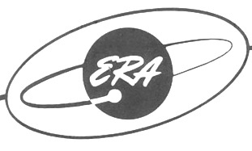
1952
ERA is acquired by Remington Rand
1955
Sperry buys Remington Rand and becomes…

Slide 6
Frustration with corporate red tape causes William Norris, Cray and others to leave and start Control Data in 1957.

Slide 7
1960’s
Control Data along with Sperry Univac, Honeywell and IBM Rochester make Minnesota
a leading force in the computer industry.
Their presence inspires teachers at the University of Minnesota College
of Education to introduce computers into Minnesota’s high school classrooms.

Slide 8
1972
Seymour Cray leaves Control Data to start Cray Research

Slide 9
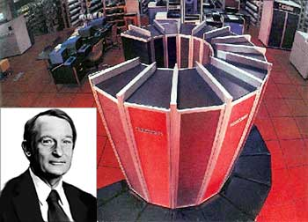
Cray Research helps Minnesota become the super computer capital of the world
in 1970’s & 80’s.

Slide 10
&

Slide 11
Without Cray’s pioneering technology developed when he created the fastest computers in the world, the personal computing revolution could not have happened.

Slide 12
OK, what about the Geek Squad?

Slide 13
1990
Robert Stephens leaves a scholarship at the Art Institute of Chicago to pursue a degree in the renowned computer science department at the University of Minnesota.
He remembers the first time he saw the Internet; in a research laboratory at the University of Minnesota in 1990 and and likens the moment to the
California Gold Rush.

Slide 14
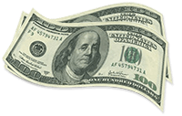
1990
Robert starts his computer consulting business with $200.
While attending the University, he lands a job fixing computers for the Human Factors Research Laboratory.

Slide 15
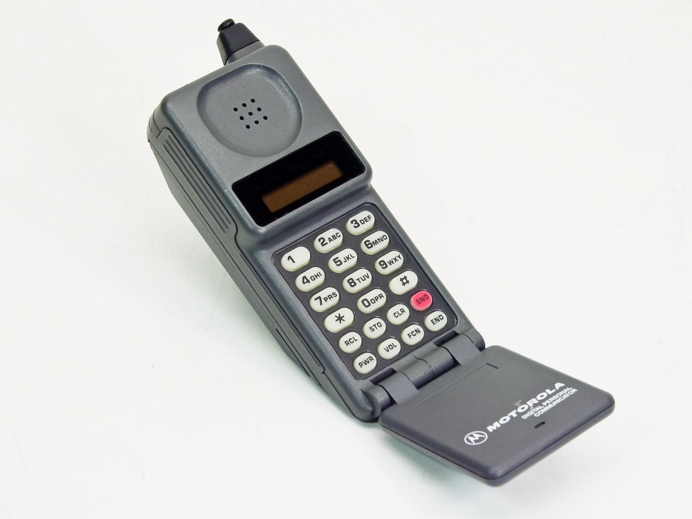
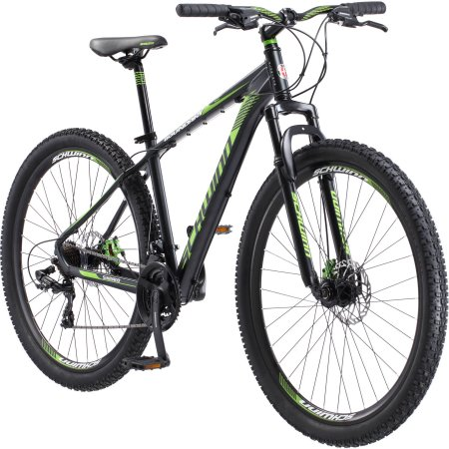
With a cell phone and a mountain bike as his office,
Robert’s computer repair business starts rolling.
One of Robert’s first customers was a young copywriter in Minneapolis (yep, me).

Slide 16
Robert Stephens launches Geek Squad in Minneapolis.
1994

Slide 17
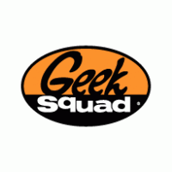
2002
Geek Squad is purchased by another Minneapolis company, Best Buy.

Slide 18
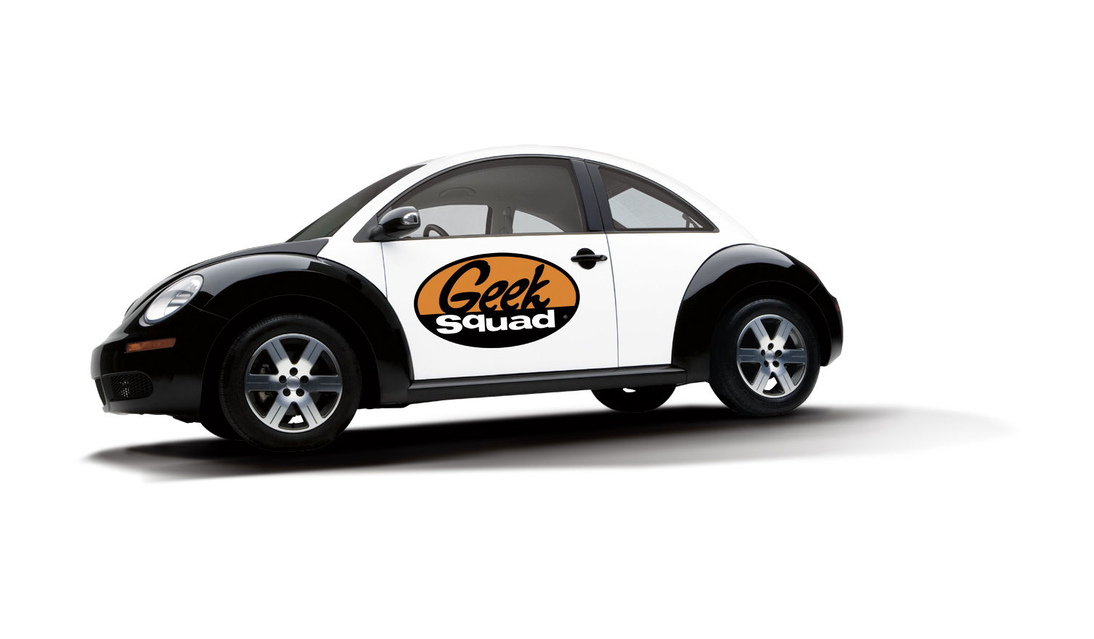
2004
Geek Squad is rolled out throughout the U.S. and Canada, eventually expanding beyond its computer tech origins to help with everything from appliance repairs to car, home theater and smart home installations.

Slide 19
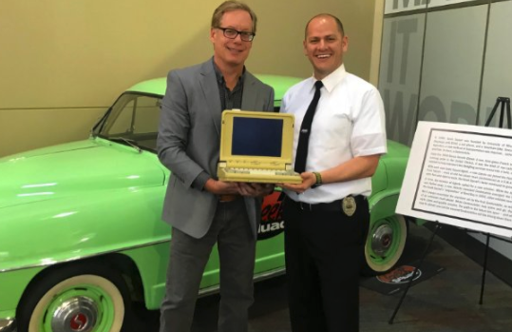
2017
I present the laptop Robert Stephens repaired for me back in 1992 to current Geek Squad Chief Inspector Nate Bauer for the Geek Squad archives.

